Slide 1
Images for Small Basic Programs
Nonki Takahashi

Slide 2

How to Create Image From Shapes
Create Shapes from [INSERT] [Illustrations] [Shapes] Menu
Select the Shapes, Click Mouse Right Button and [Group] Them
Select the Group, Click Mouse Right Button and [Save as Picture]

Slide 3


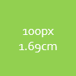
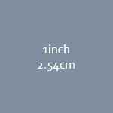
How to Determine the Size of Image
10.13 x 7.24 cm
598 x 428 px
GraphicsWindow Size
0.48 pt
1 px
1inch
2.54cm
100px
1.69cm
40px
0.68cm
1cm
Original Shapes
Images
0.68 cm
40 px
1 cm
59 px
1.69 cm
100 px
1 in
150 px

Slide 4
How to Design Icon
10.13 x 7.24 cm
598 x 428 px
GraphicsWindow Size
Original Shapes
Images
0.34 cm
20 px
Create Shapes from [INSERT] [Illustrations] [Shapes] Menu
Select the Shapes, Click Mouse Right Button and [Group] Them
Select the Group, Click Mouse Right Button and [Save as Picture]
Removed Background with GIMP

Slide 5
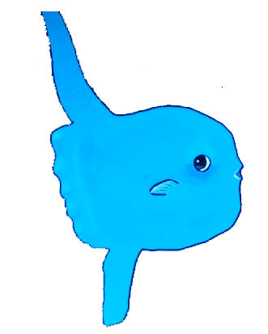
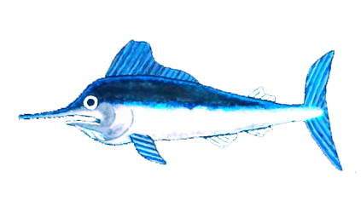


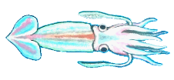


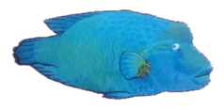
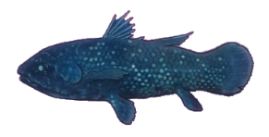

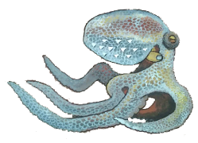
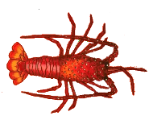
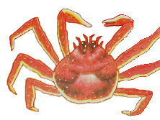




Animals in the Sea
10.13 x 7.24 cm
598 x 428 px
GraphicsWindow Size
Drawn with Acrylics and Scanned
Removed Background with GIMP

Slide 6
Halloween Images (1)
Created as SB Program and Converted to PowerPoint VBA
10.13 x 7.24 cm
598 x 428 px
GraphicsWindow Size
You can see the VBA by clicking [VIEW] [Macros], selecting “DrawCandy” and clicking [Edit]
Original converted from XQD349-0
Candy1.png
Color changed
in PowerPoint
Candy2.png
Col0r changed
in PowerPoint
Candy3.png

Slide 7
Halloween Images (2)
10.13 x 7.24 cm
598 x 428 px
GraphicsWindow Size
Created with macro “DrawLightJack”
Original program ID is XQD349-1
Size changed in PowerPoint by
[Group]
[Size and Position]
[Lock Aspect Ratio]
[Scale Height] 100% -> 20%
LightJack.png

Slide 8
Halloween Images (3)
10.13 x 7.24 cm
598 x 428 px
GraphicsWindow Size
Created with macro “DrawOpenBat” and “DrawCloseBat”
Original program ID’s are XBB765, WTR742 and XQD349-2
Size changed in PowerPoint by
[Group]
[Size and Position]
[Lock Aspect Ratio]
[Scale Height] 100% -> 20%
OpenBat.png
CloseBat.png

Slide 9
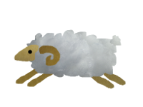
Sheep for 2015
10.13 x 7.24 cm
598 x 428 px
GraphicsWindow Size
3.38 x 2.54 cm
Original image size
200 x 150 px
7.06 x 5.29 cm

